Slide 1
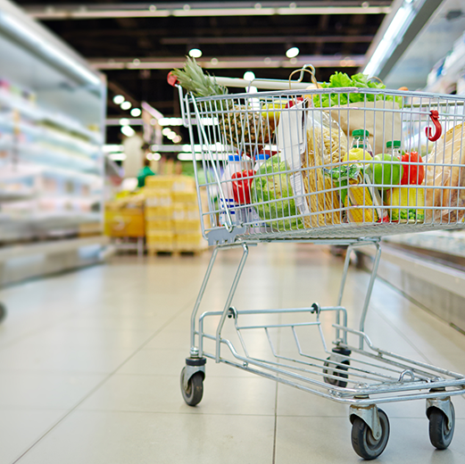
VISUAL ANALYTICS-(DSBA 5122) GROUP PRESENTATION- “SUPERSTORE”
By - Sreelekha, Srivatsav, Vatsav Kolluru , Jaswanth

Slide 2

SCENARIO
Store Manager have some information about the customers such as Customer Name, Basic Segment, Region, and Products sold and is looking for ways to understand customers' behavior and future trends to create a targeted marketing strategy.

Slide 3

SUB PROBLEMS
Explore and review past transactional data to understand where profitability and customer experience is lacking.
Understand buying patterns of customer group with products that sold together.

Slide 4
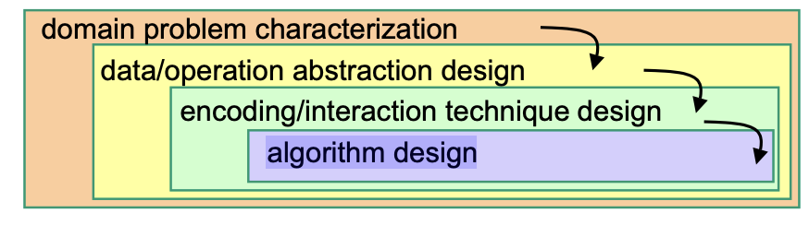
NESTED MODEL FOR VISUALIZATION DESIGN
A Nested Model is a Four layered linkage model
Four Layers:
Domain problem characterization
Data/operation abstraction design
Encoding/interaction technique design
Algorithm design

Slide 5
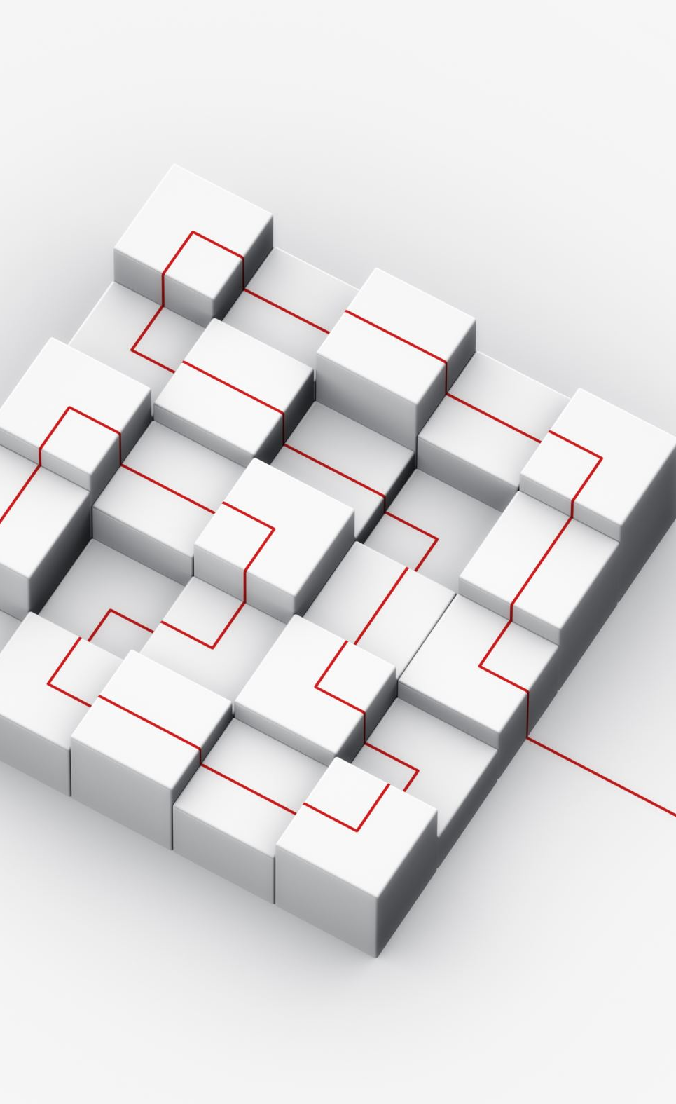
Challenges of NESTED MODEL
The difficulty with this layering is that any upstream error
will automatically overflow to all downstream layers.
If a bad abstraction decision was chosen, even great visual encoding and algorithm design will not result in a visualization system that addresses the desired issue.

Slide 6

DOMAIN
What to Target?
-> “Customers to understand the customer’s behavior”
Objectives: To create a targeted marketing strategy.
Overview: To analyze and find what factors affect profits of superstore
Provide the super store with a better pricing and marketing strategy.

Slide 7

Abstraction design
Order size, order value, categories and subcategories were used to divide best and worst customers.
Delivery delays were analyzed using expected date of delivery vs actual delivery date.
Quantitative data types like sales and profit etc were transformed into bins, categories etc.. , these data types will pass as an input to the next encoding layer.
Retention rate is calculated based on customers shopping frequency.

Slide 8
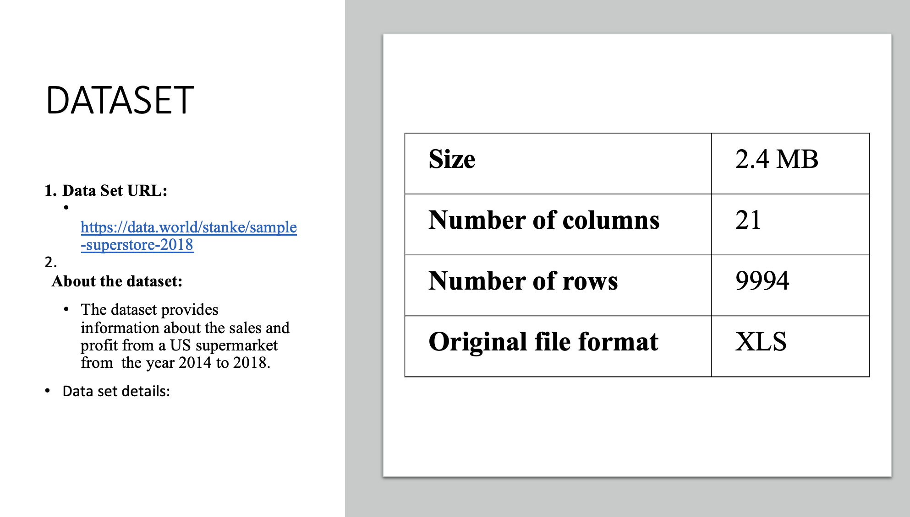

Slide 9
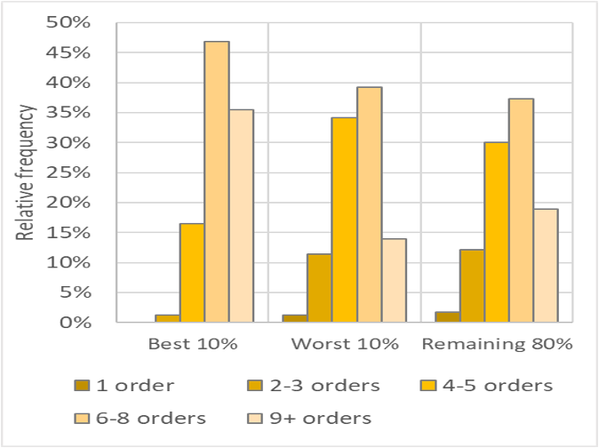
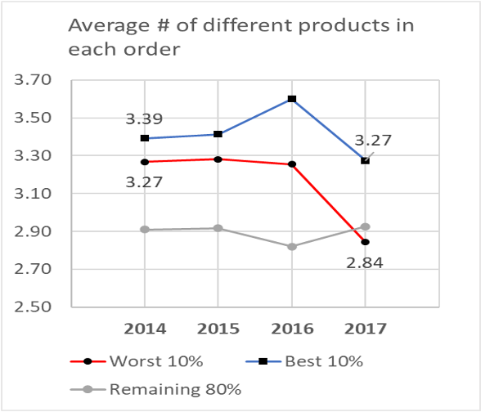
VISUAL ENCODING
Relative frequency of orders per customer Order size
The worst 10% customers have Overall the order sizes are similar. In 2021
similar ordering frequency as the average order sizes of the worst 10% of
the remaining 80% group of the customers decreased. The best 10% saw a
Customers. Smaller decrease.

Slide 10
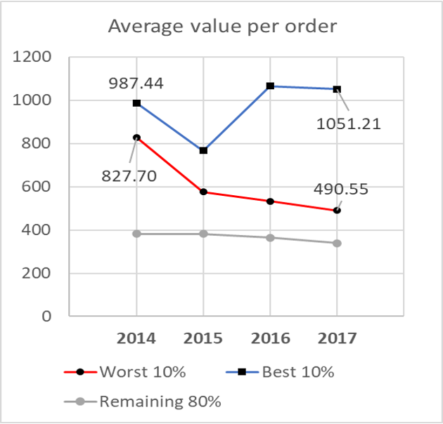
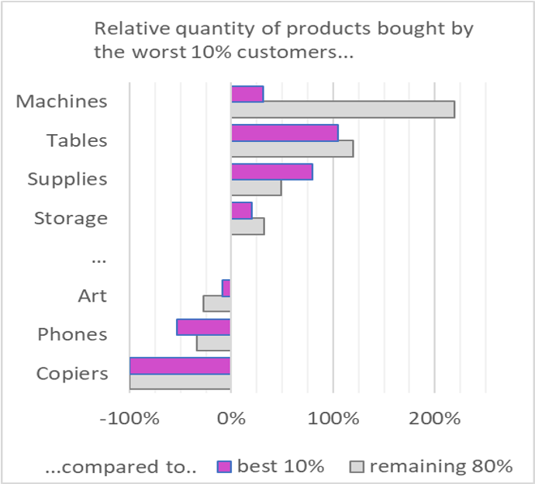
Order value
Order people are ordering?
The average value per order among the No customer in the worst 10% have ordered copier,
worst 10% customers is seeing a significant products from the sub categories Machines, Tables and
Decrease. Supplies are most frequently ordered.

Slide 11
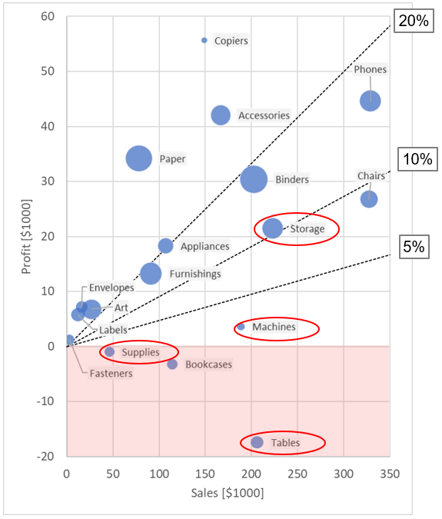
Product Sub-categories
Previously, we noted that unprofitable customers have higher ordering frequency for Machines, Tables, Supplies & Storage
The Tables sub-category performs especially poorly
Supplies and Bookcases are also generating a net loss

Slide 12
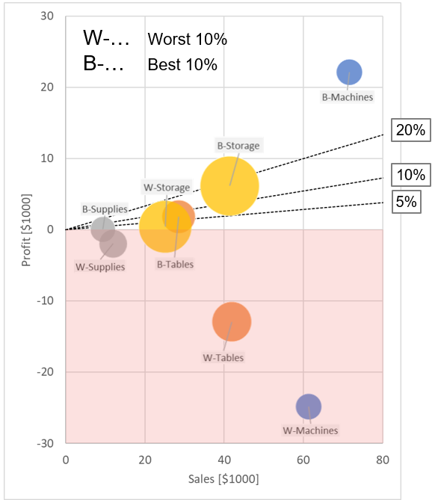
Product Sub-categories: Best & worst customers
Supplies
Smallest separation both in terms of profit and sales between the two different groups of customers. -14% and 1% gross profit margin, respectively.
Storage
Larger separation both in profits and sales 2% and 18% GPM
Tables
Even larger separation, especially in terms of profit. -24% and 7% GPM
Machines
Very large separation in terms of profit. -29% and 45% GPM

Slide 13
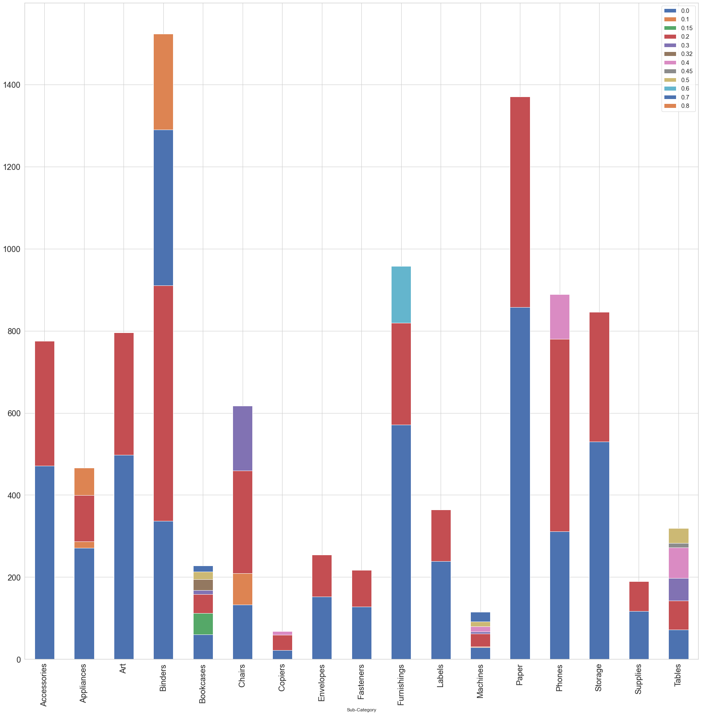
Products sold with discount
Products sold with 60% above discount rate incurred most of the losses to the store.
Bookcases and Machines are mostly sold with a discount. They are also the ones where the store is incurring most loss.
These discounts were very prominent in the state Texas..

Slide 14
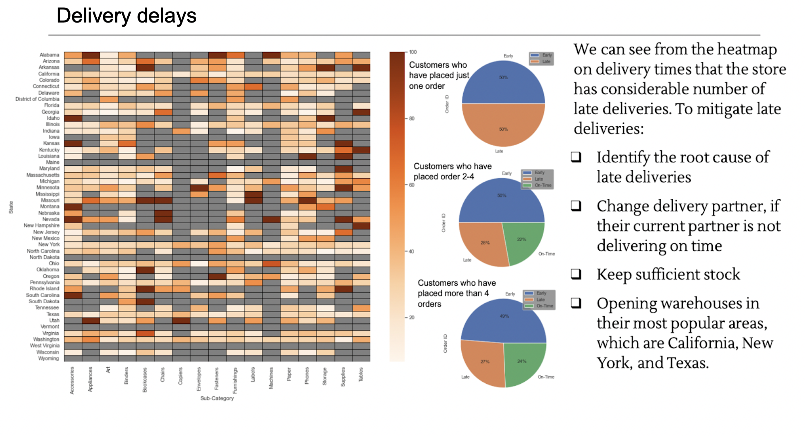

Slide 15
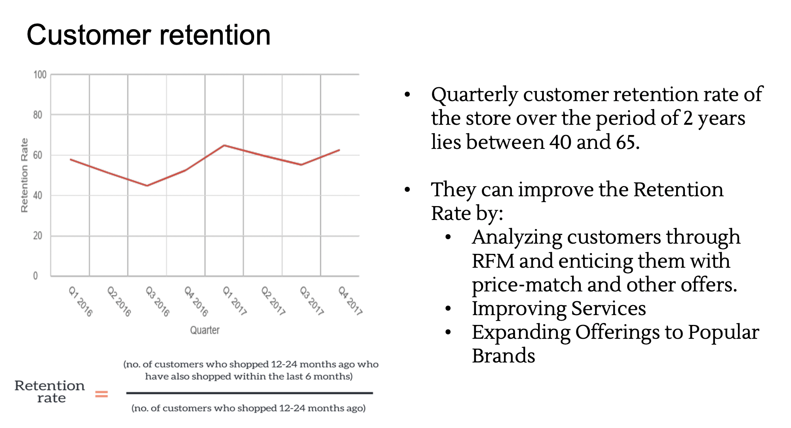

Slide 16

Algorithms
Market basket analysis (Apriori algorithm)
-> To provide product recommendations.
Customer segmentation (RFM analysis)
-> To segregate best, loyal, recent and lost customers.
Future price predictions ( Regression )
-> Predict the future prices of the products sold by super store.

Slide 17

THANK YOU

Slide 18

ANY QUESTIONS?

